Slide 1

Back-End Development
End Term Project

Slide 2
Library management Project
Name: Dhruv Garg
Roll no: 2010993755
Branch: BE-CSE-5th Sem
Group: G-24
Trainer: Madam Divya Goyal

Slide 3



Technologies Implemented
Html
CSS, CSS3
NODE JS
EXPRESS

Slide 4
OVERVIEW
(about technologies)

Slide 5

EXPRESS (NODE js)
Express is a node Js web application framework that provides broad features for building web and mobile applications. It is used to build a single page, multipage, and hybrid web application.
It's a layer built on the top of the Node Js that helps manage servers and routes.
Express was created to make APIs and web applications with ease, It saves a lot of coding time almost by half and still makes web and mobile applications are efficient.
Another reason for using express is that it is written in JavaScript as JavaScript is an easy language even if you don't have a previous knowledge of any language. Express lets so many new developers enter the field of web development.
The reason behind creating an express framework for node Js is:
Time-efficient
Fast
Economical
Easy to learn
Asynchronous

Slide 6
Over View
(About Project topic)

Slide 7
Some Points
My project is based on Library management
Use a suitable database: Choose a database that is suitable for storing large amounts of data and can handle simultaneous requests. Examples include MySQL, MongoDB, and PostgreSQL.
Create a RESTful API: Build a RESTful API using Node.js and Express to handle HTTP requests from clients.
Implement authentication: Implement user authentication and authorization to ensure secure access to the system.
Develop CRUD operations: Develop CRUD (Create, Read, Update, Delete) operations to enable users to manage books, borrowers, and other relevant entities in the library.
Use third-party libraries: Utilize third-party libraries to simplify development, such as Mongoose for working with MongoDB, Passport for authentication, and Joi for validation.
Implement search functionality: Implement search functionality to enable users to search for books by title, author, ISBN, or other attributes.
Develop reporting functionality: Develop reporting functionality to enable users to generate reports on book availability, overdue books, borrower history, and other relevant data.
Handle book loans and returns: Develop functionality to handle book loans and returns, including due dates, fines, and borrower history.

Slide 8
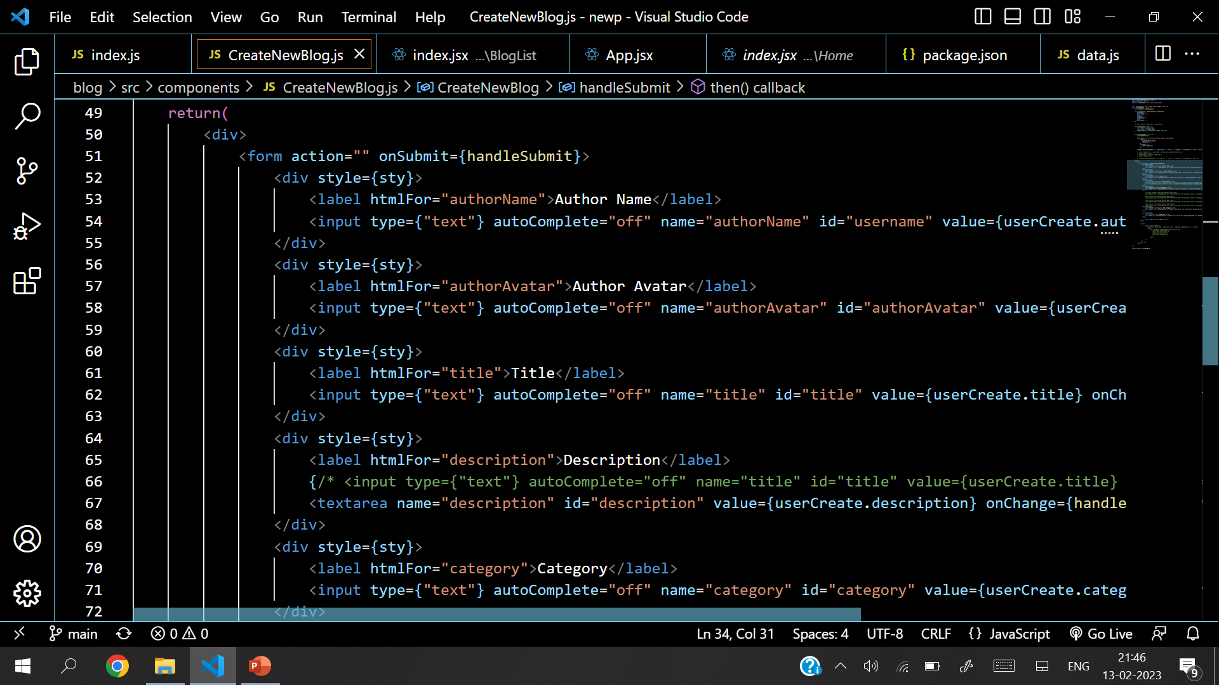
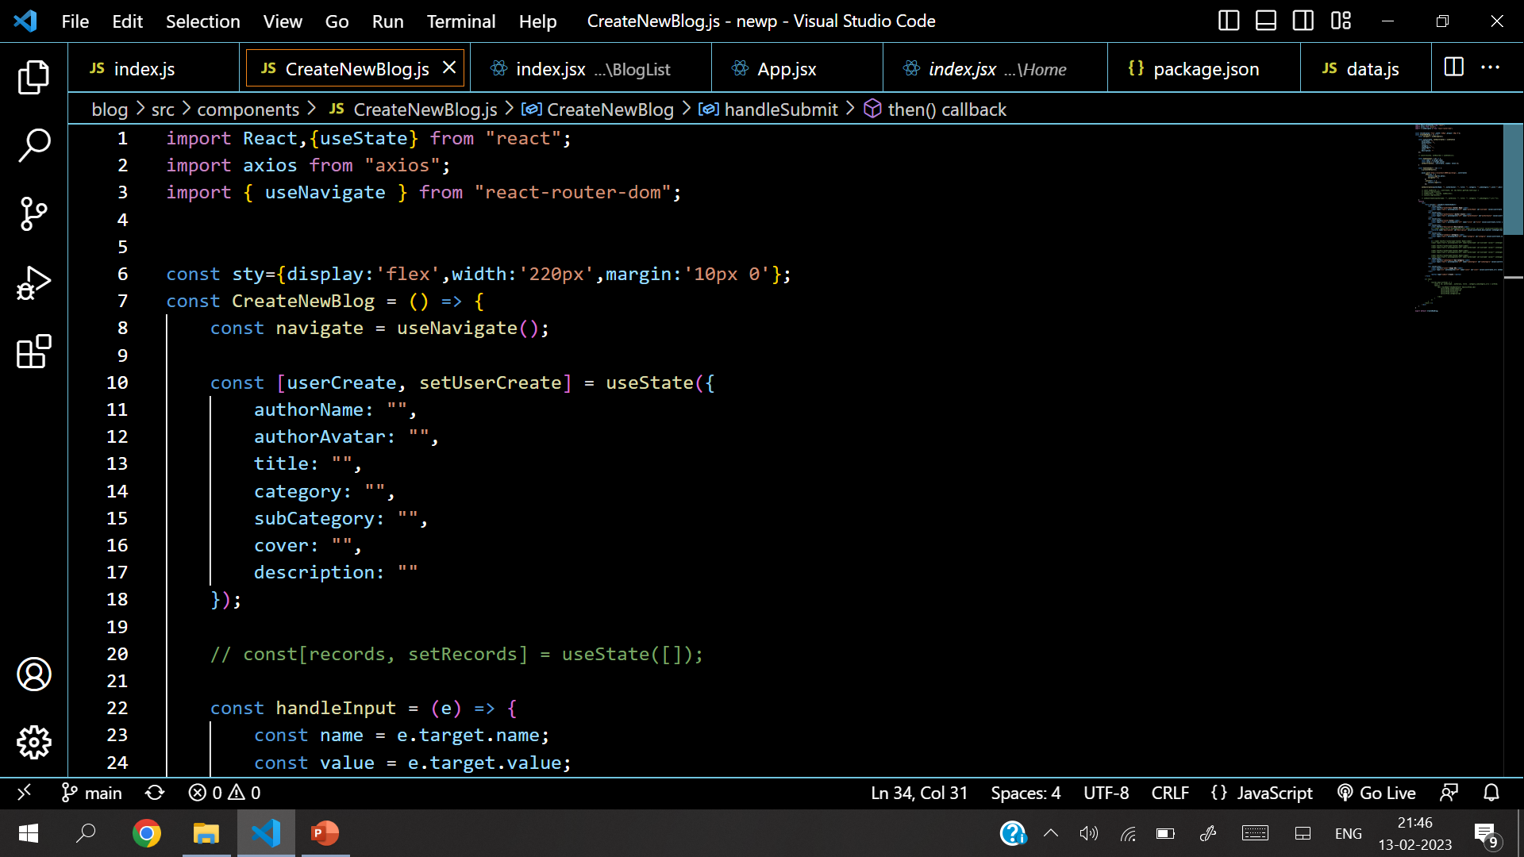
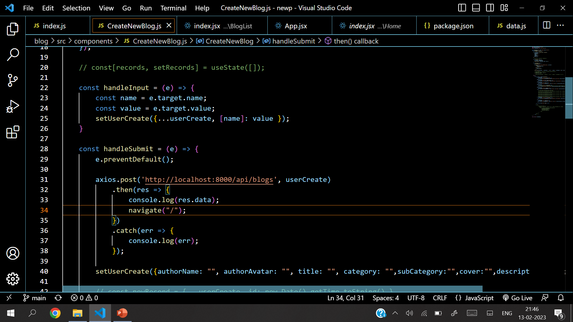
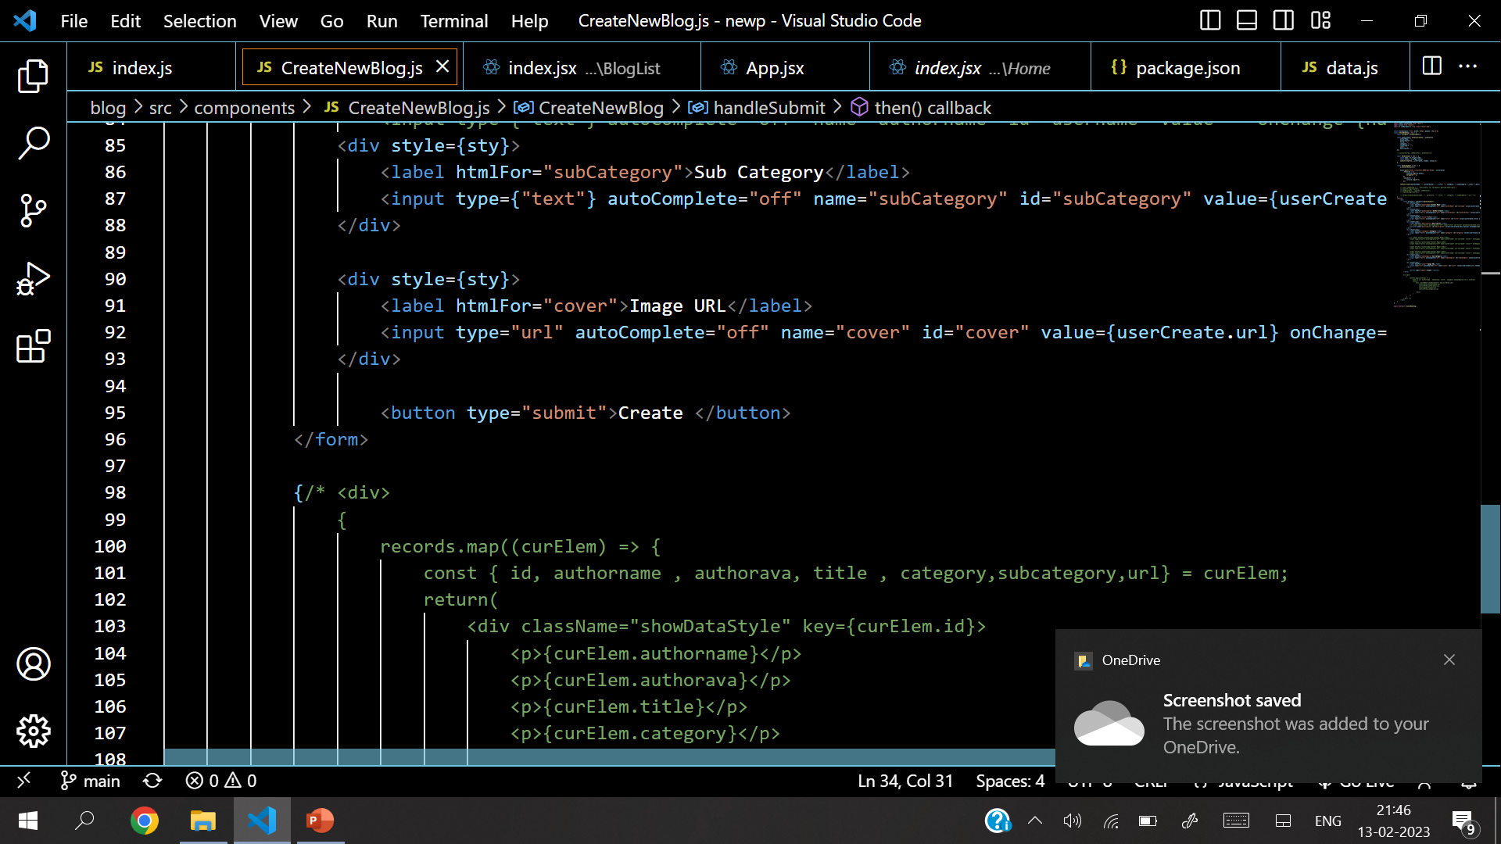
Source Code

Slide 9
Source Code

Slide 10
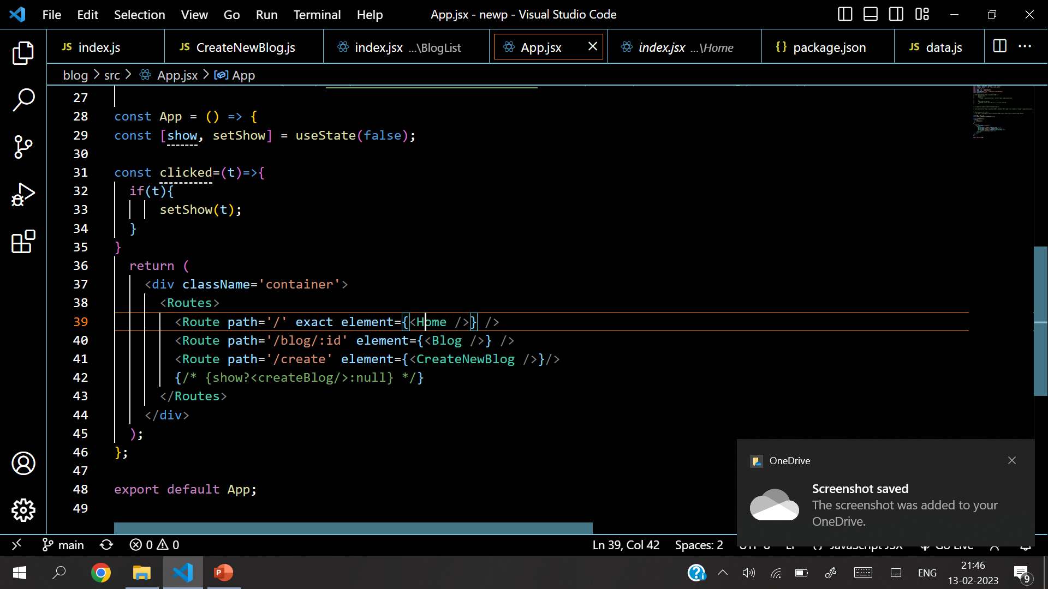
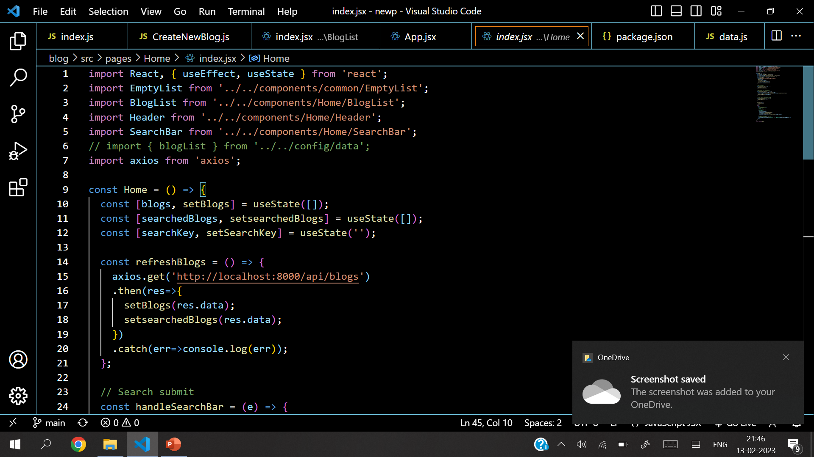
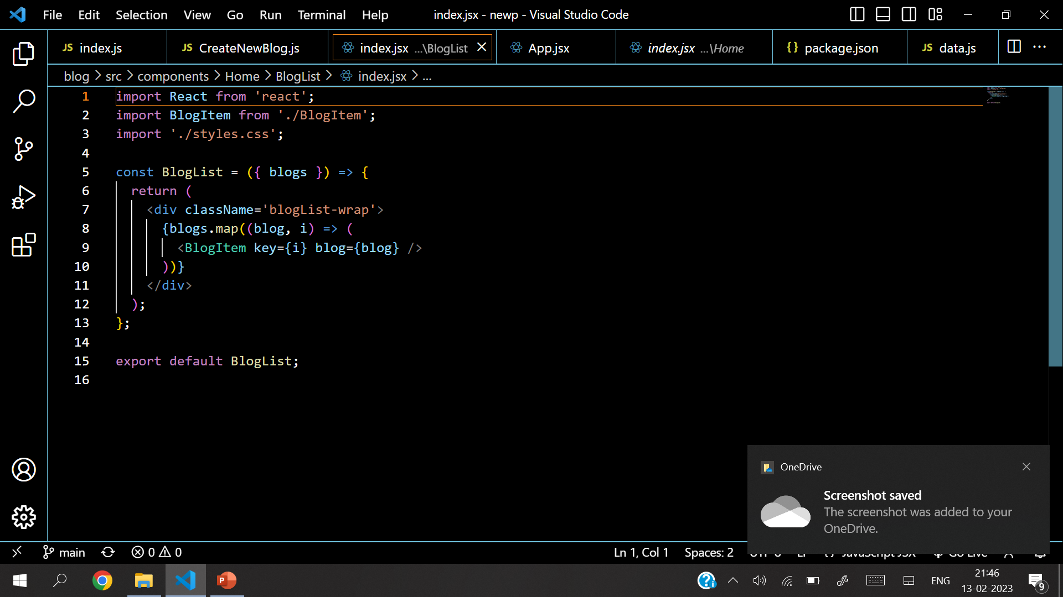
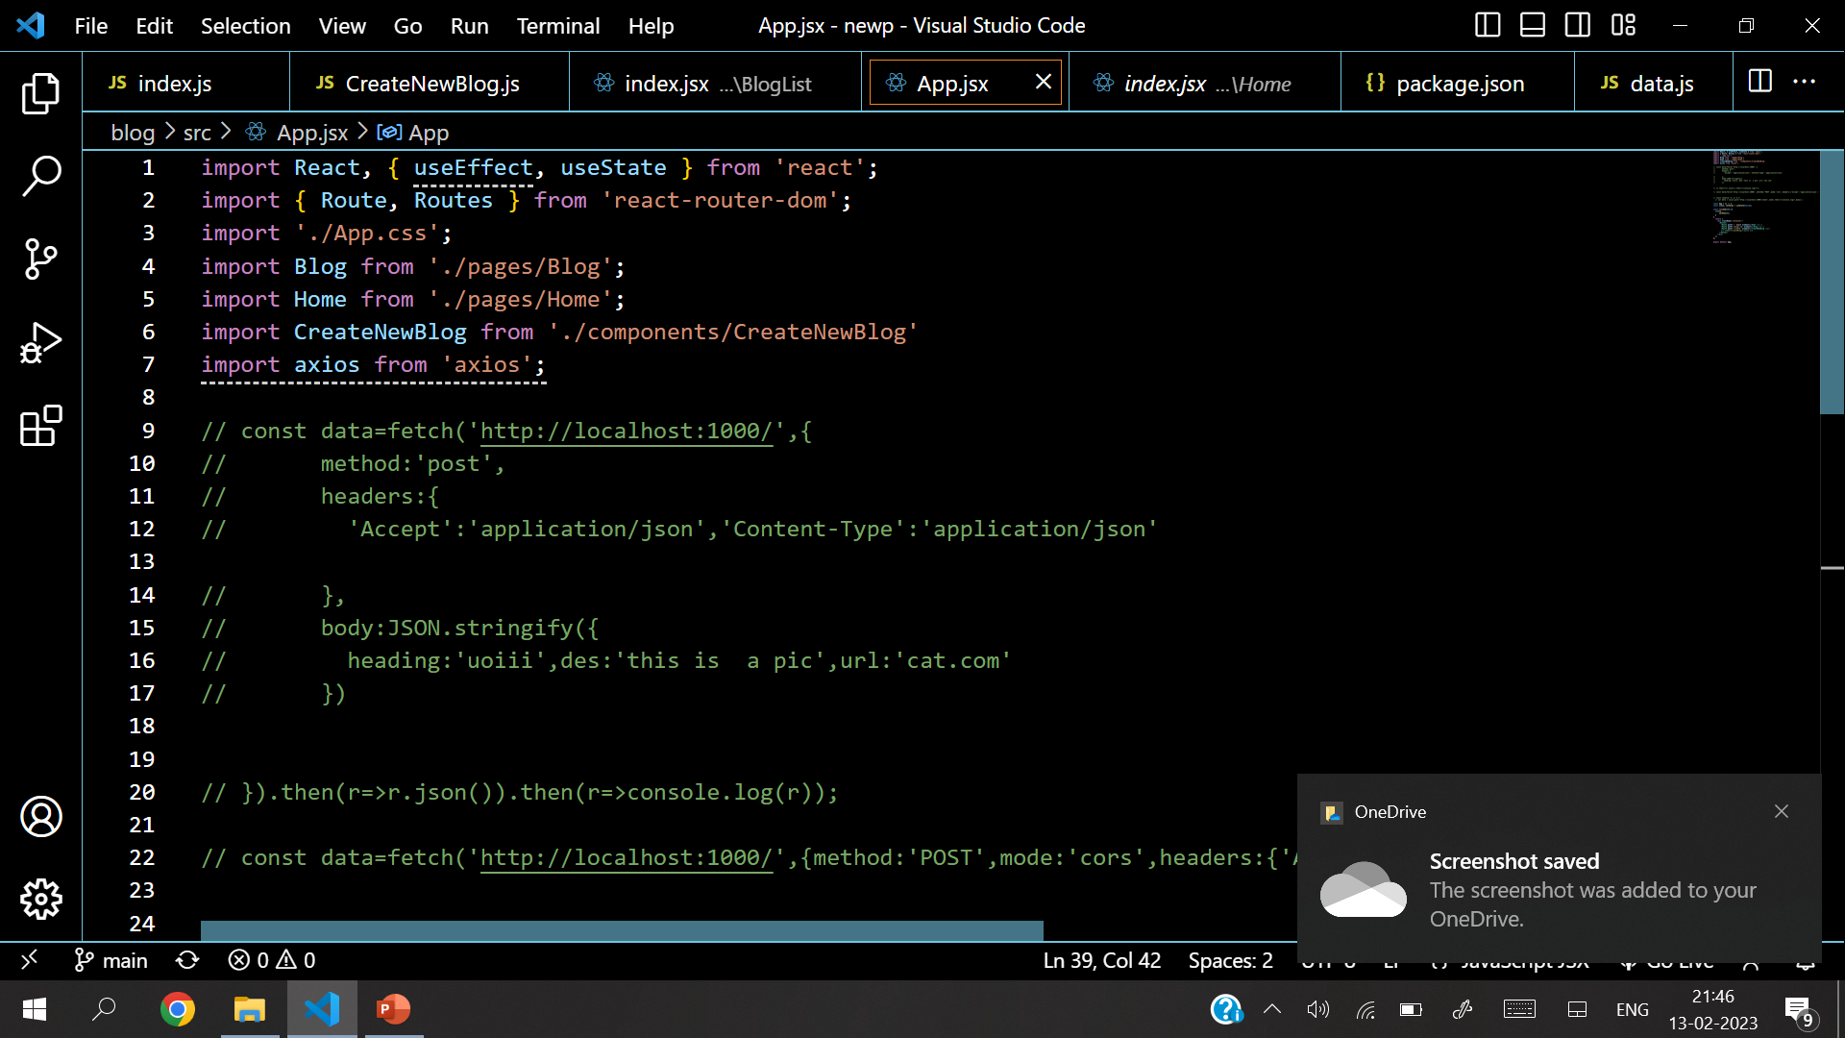
Source Code

Slide 11
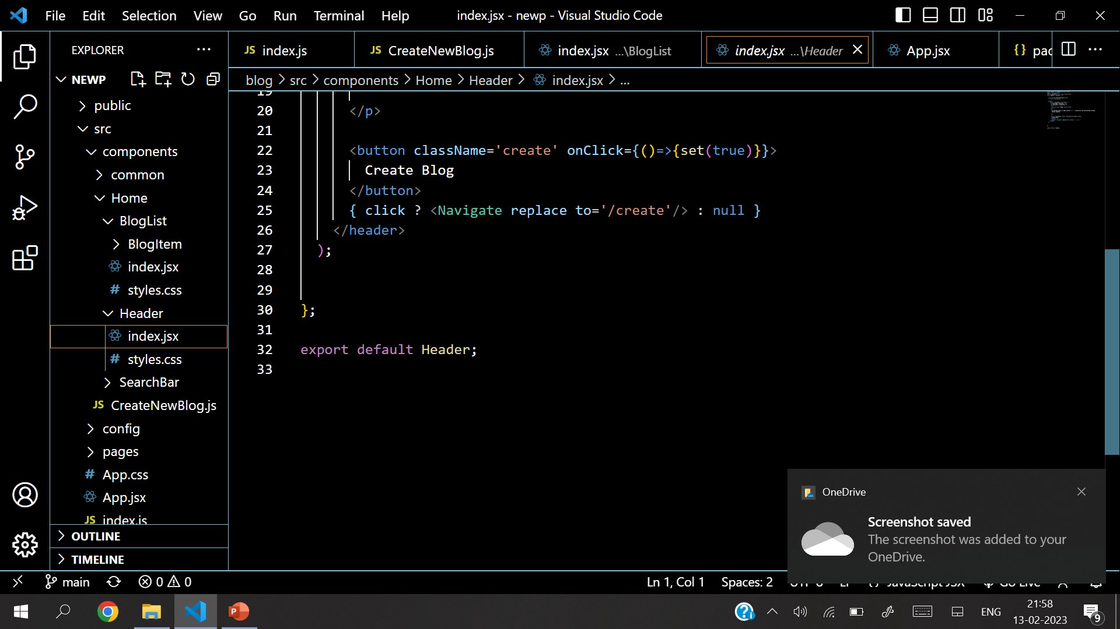
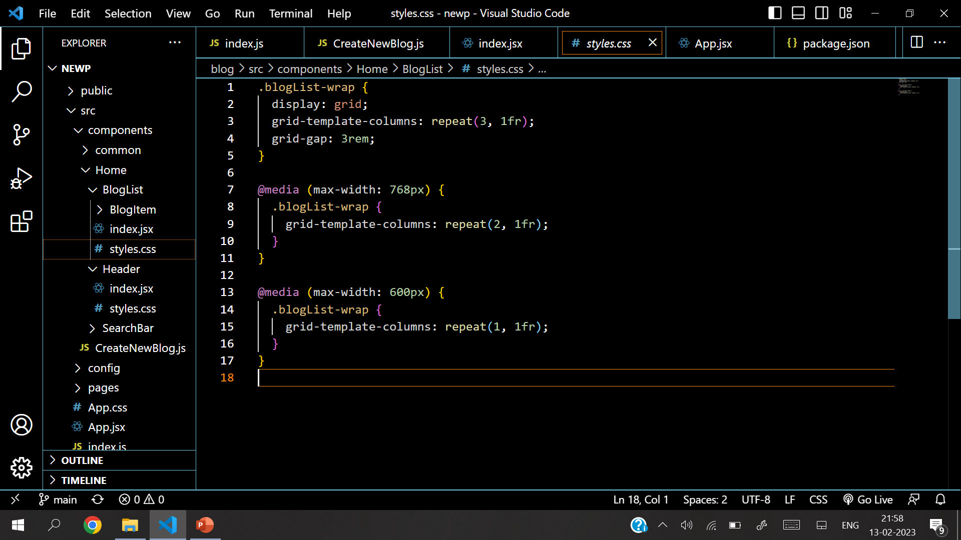
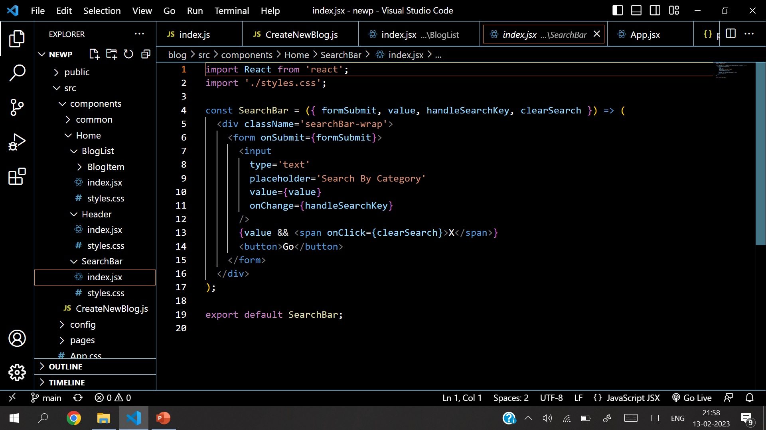
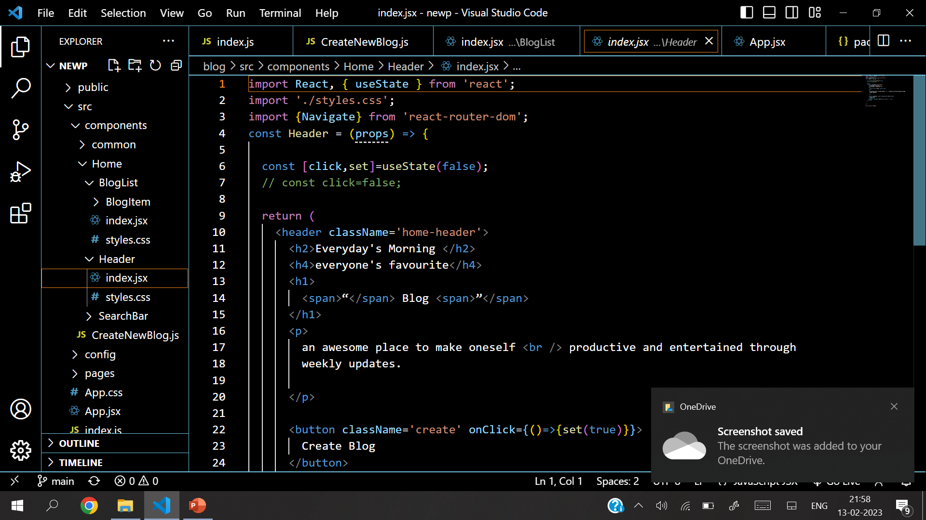
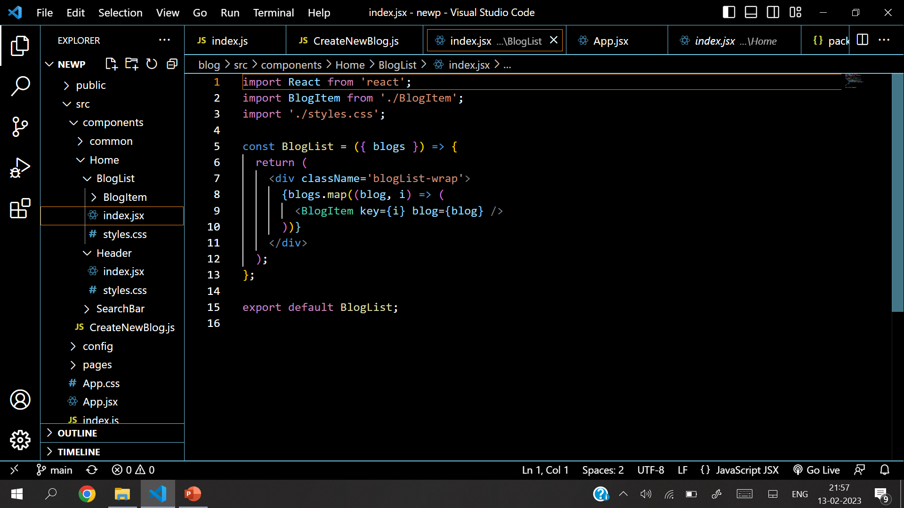
Source Code

Slide 12
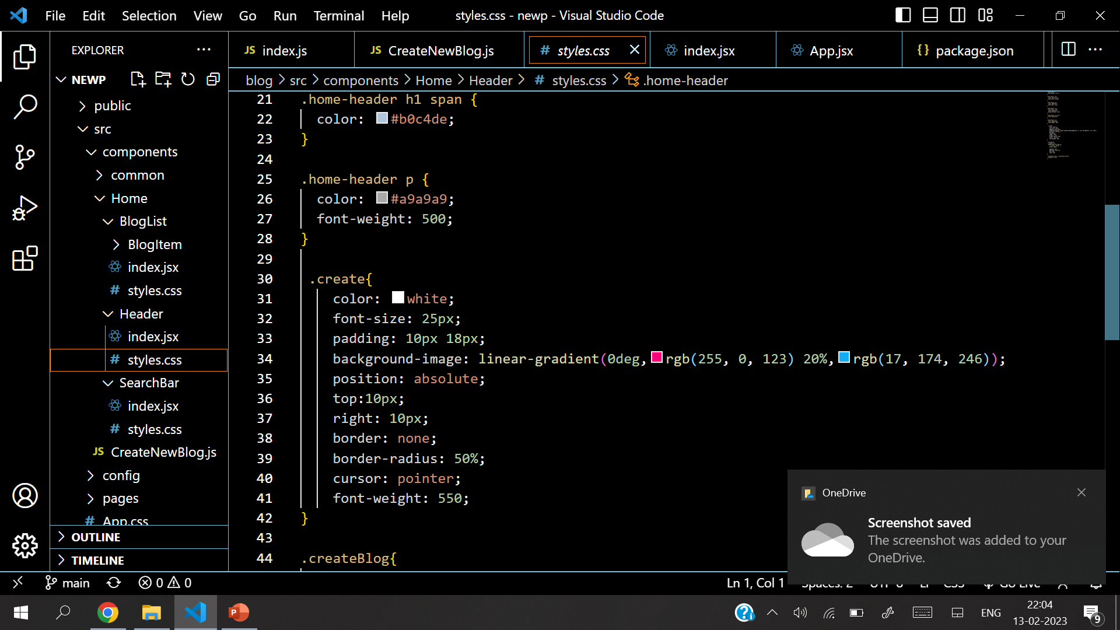
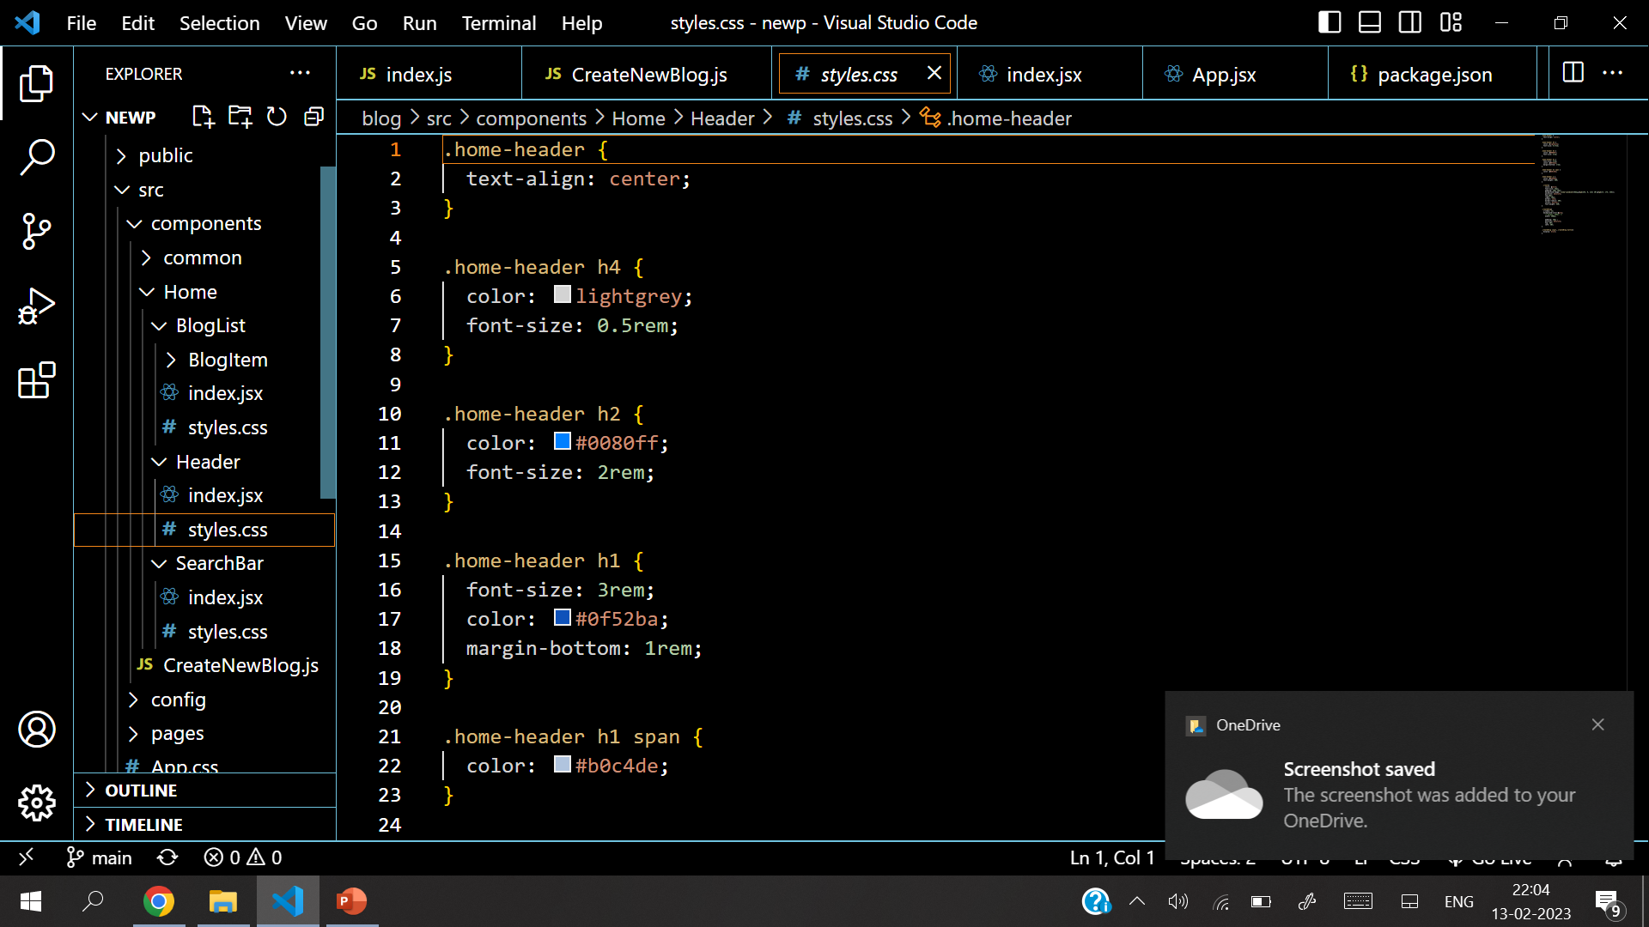
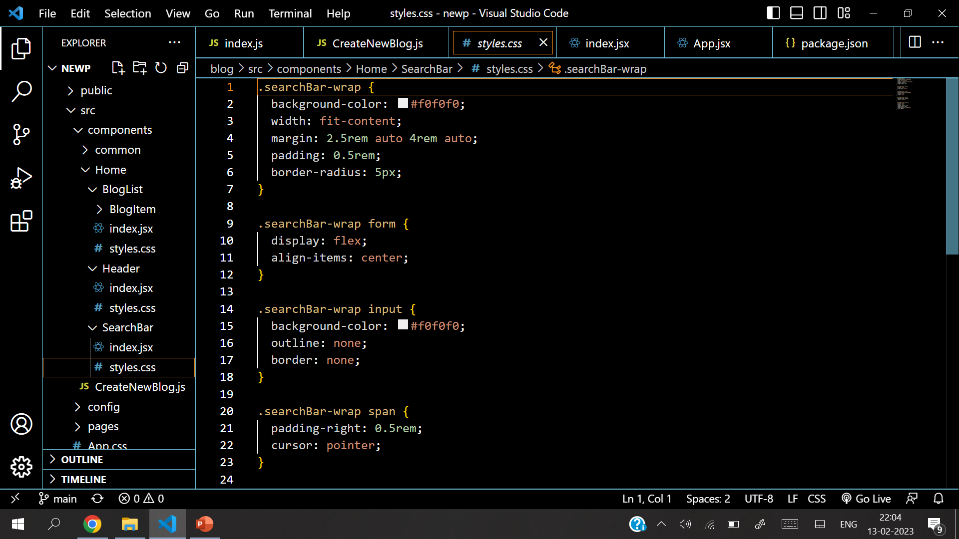
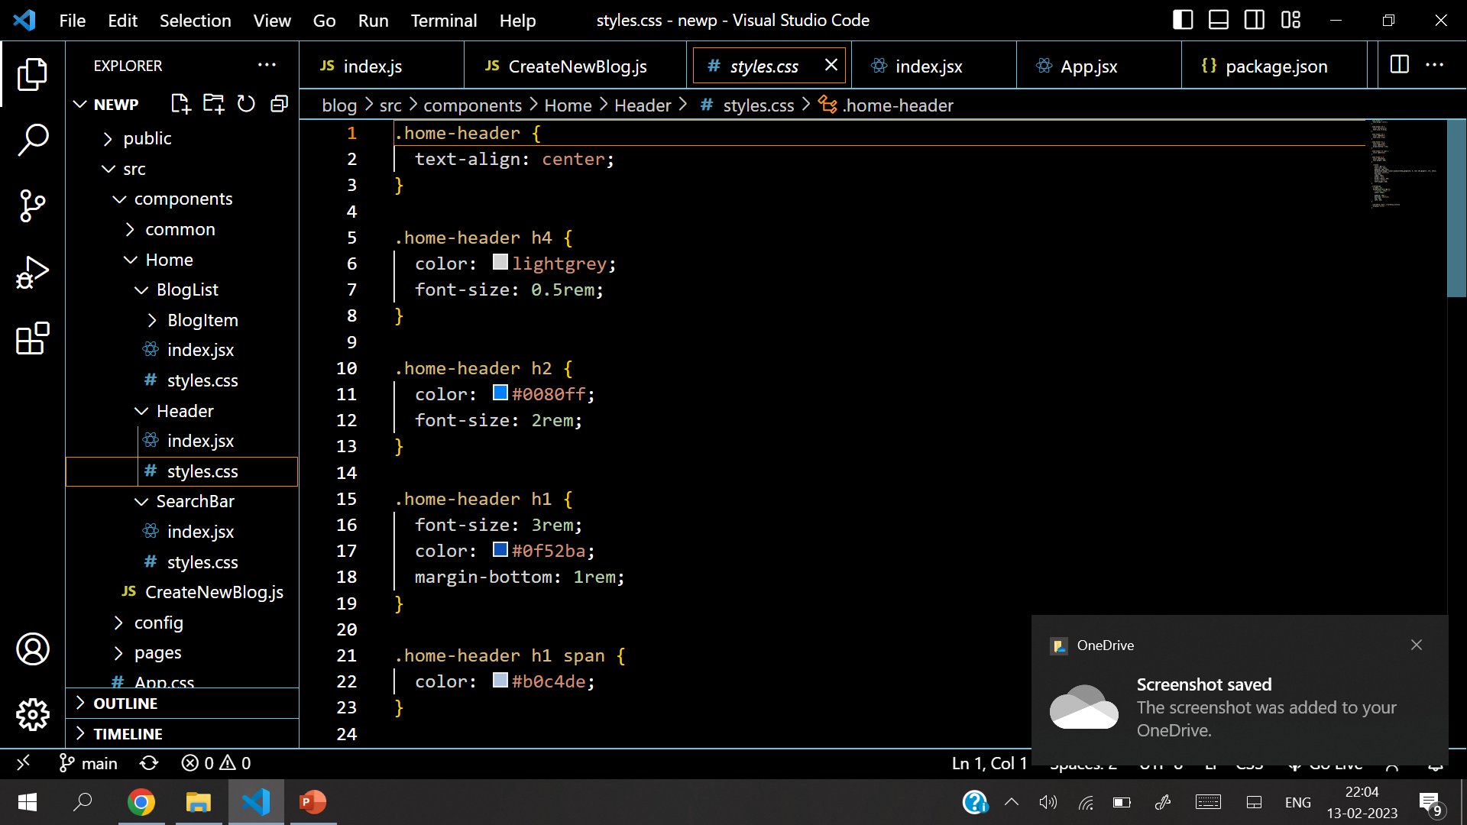
Source Code

Slide 13
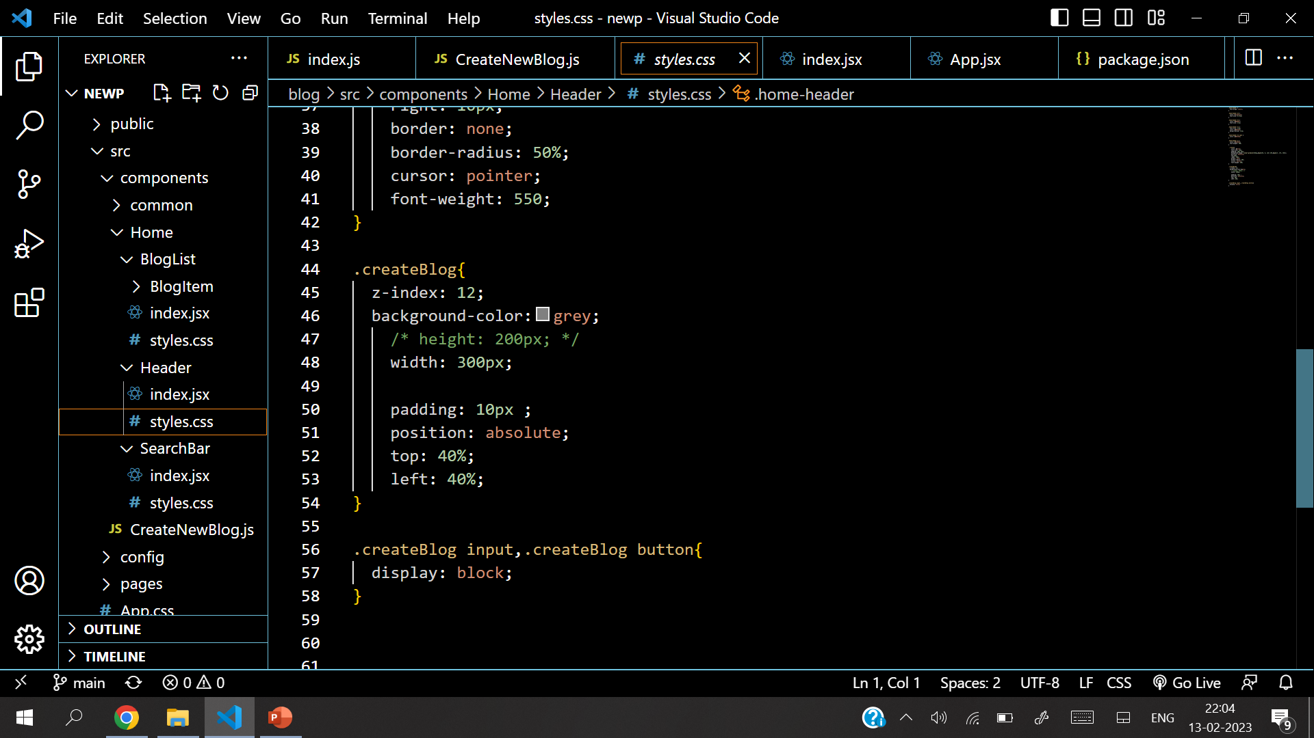
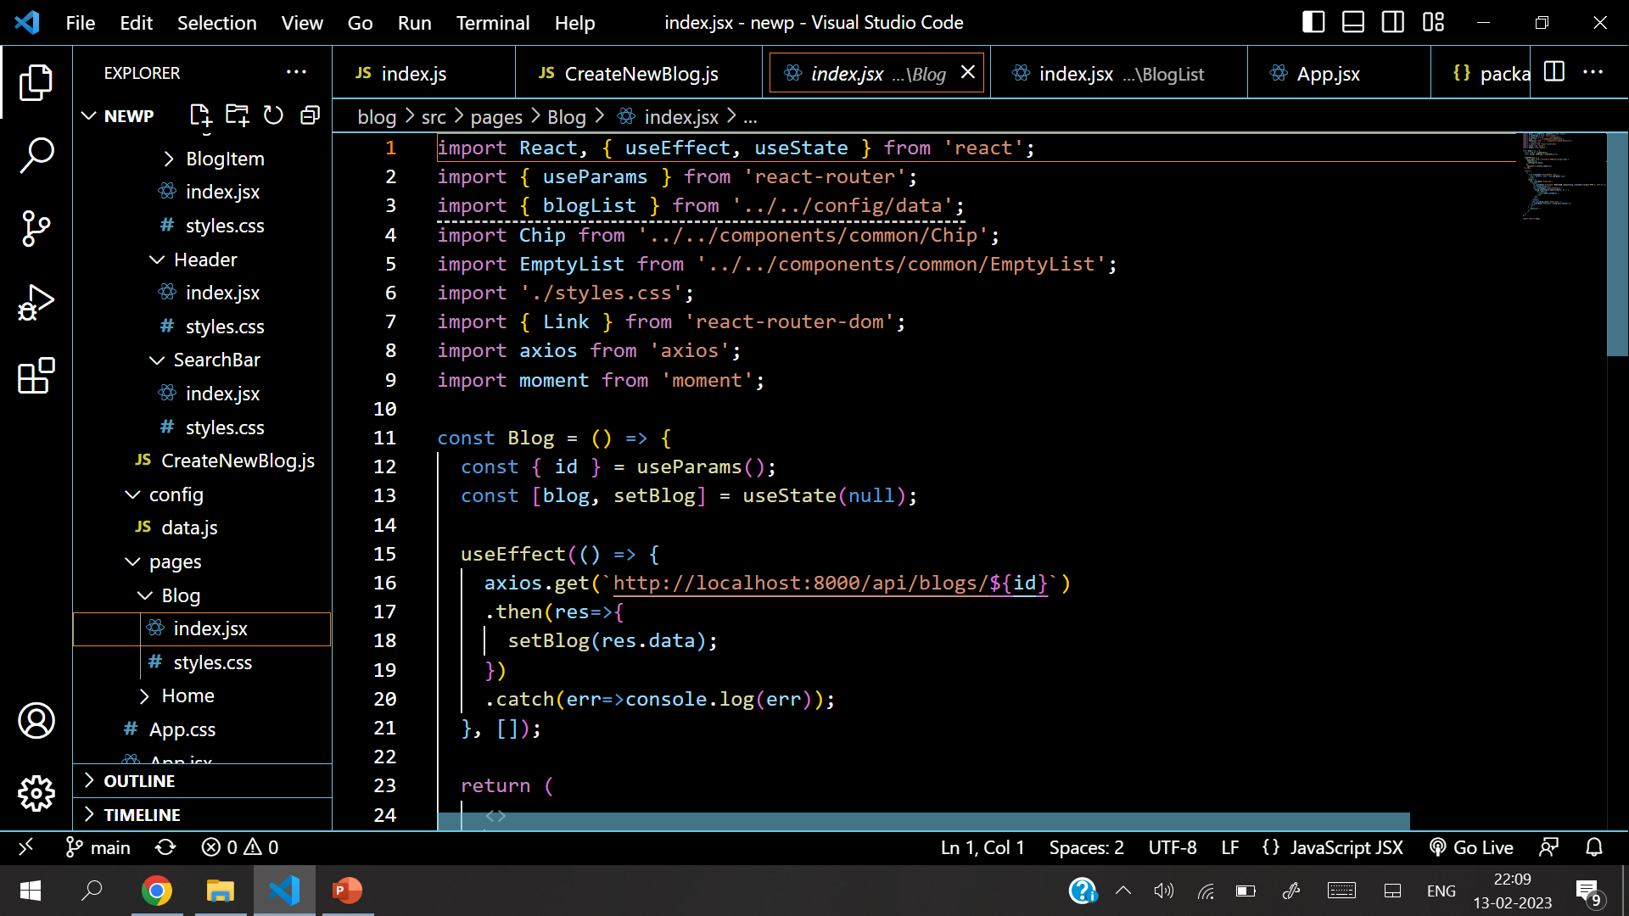
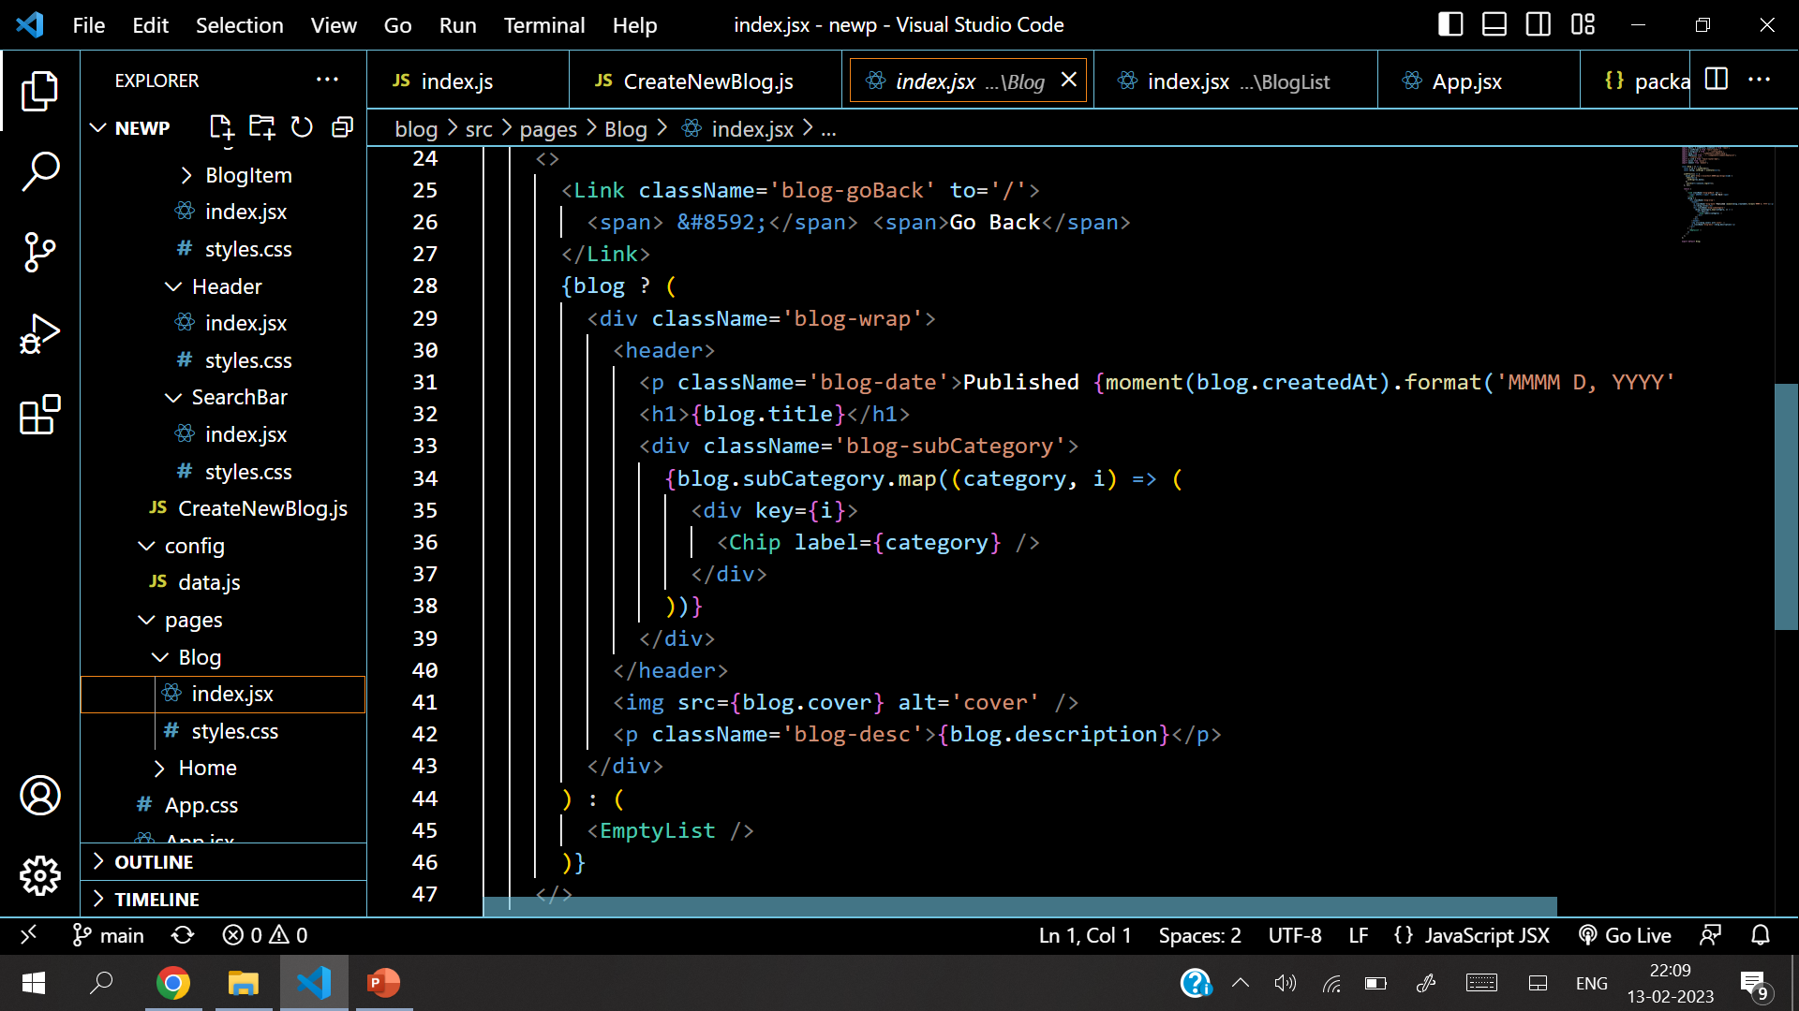
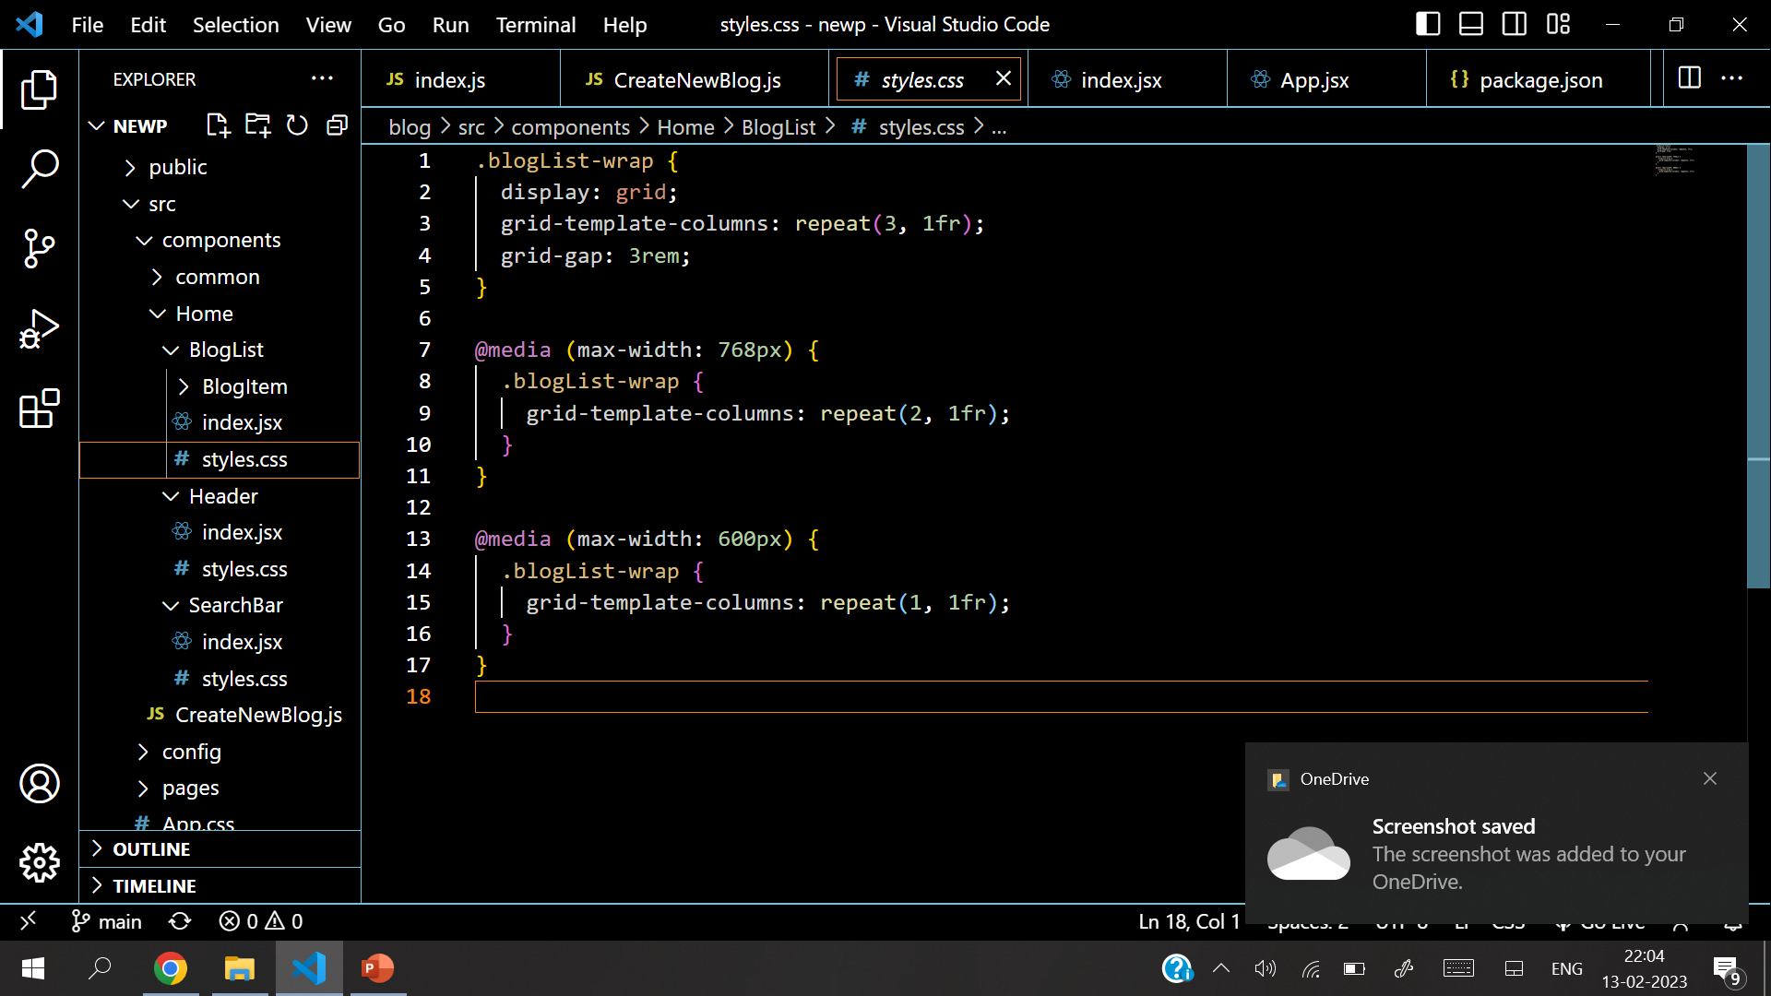
Source Code

Slide 14
Source Code

Slide 15
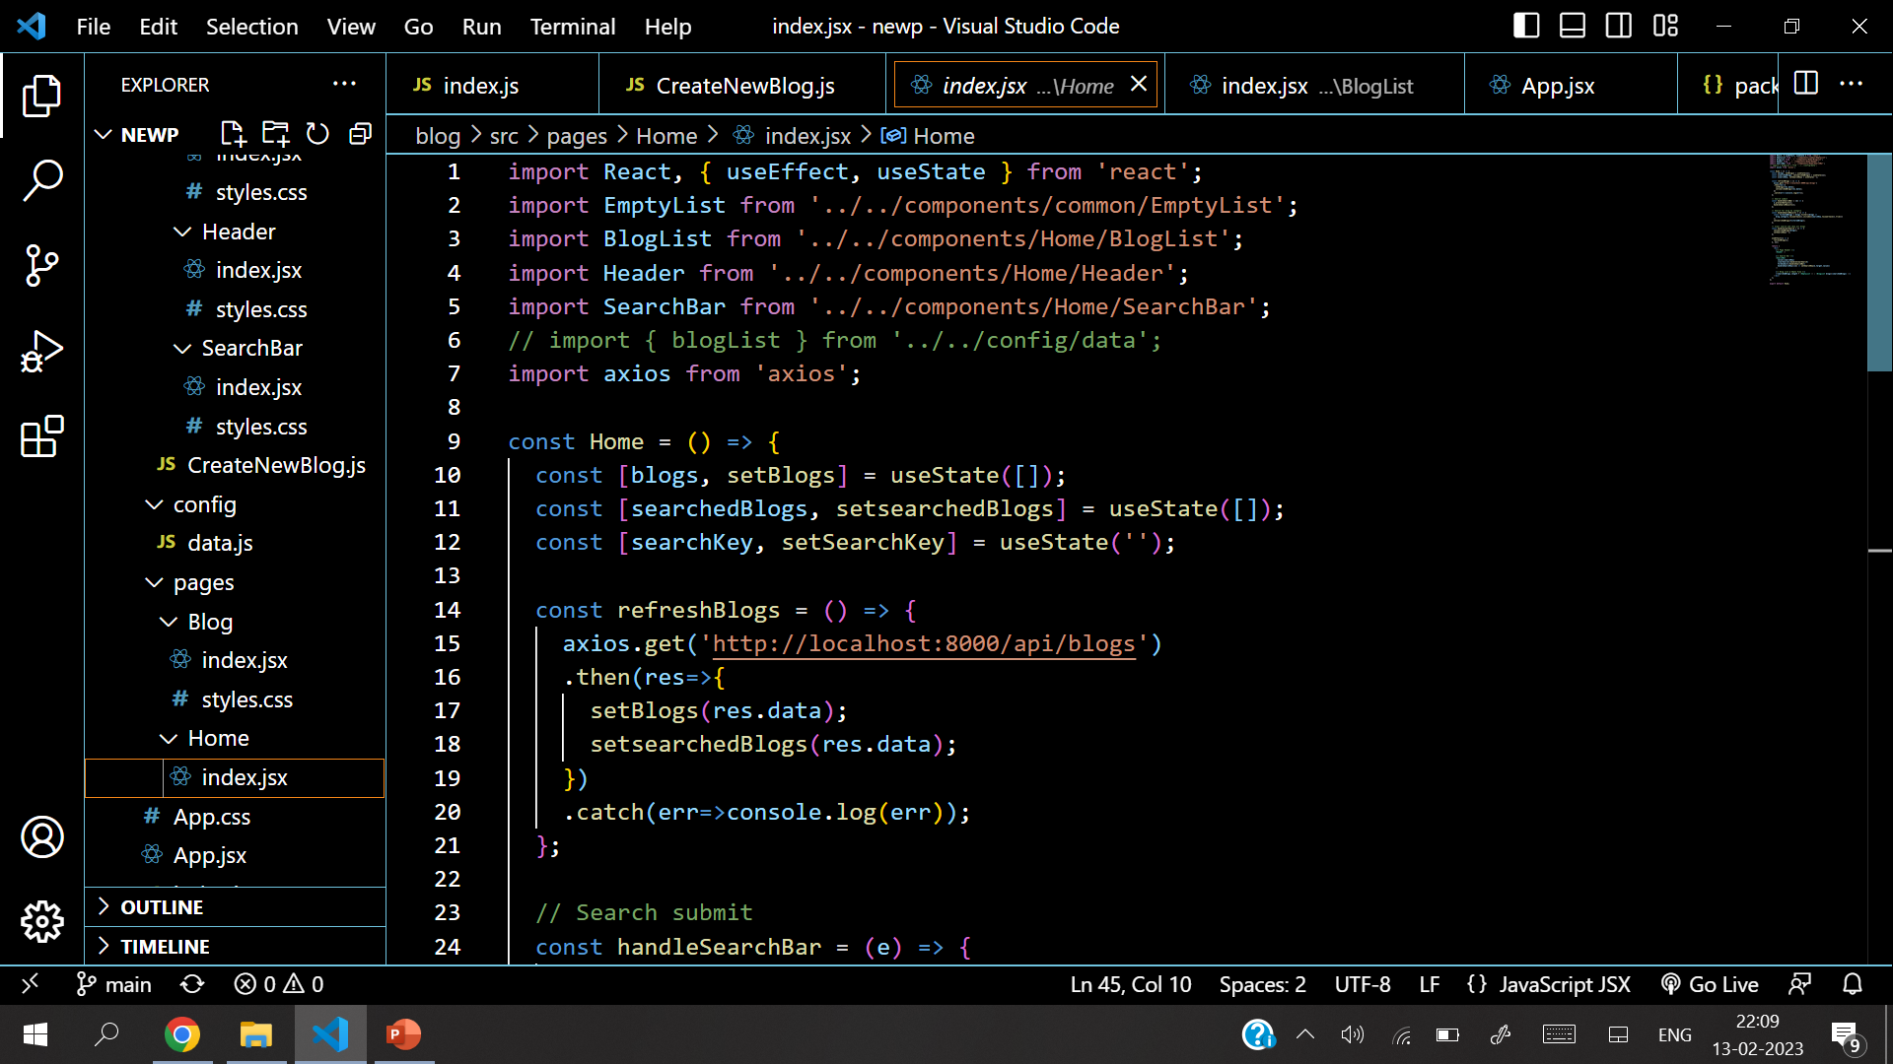
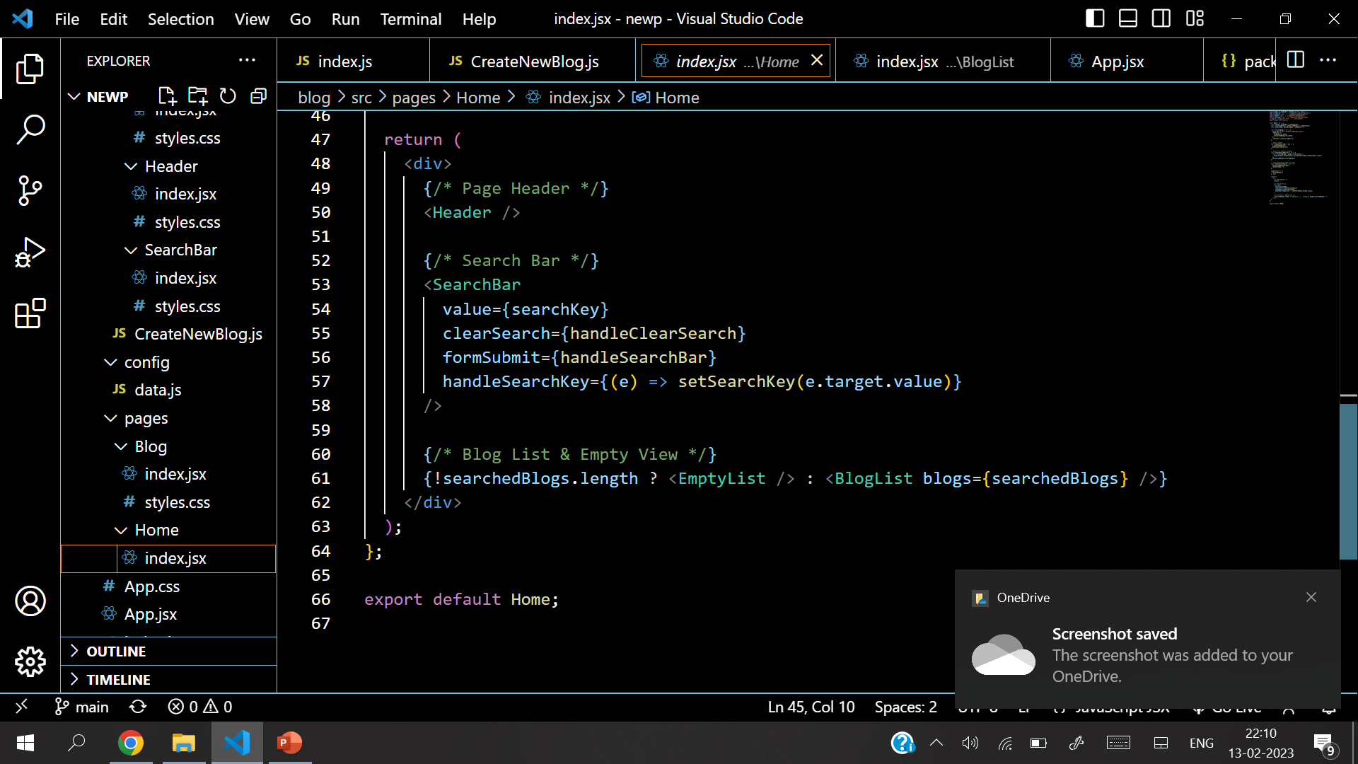
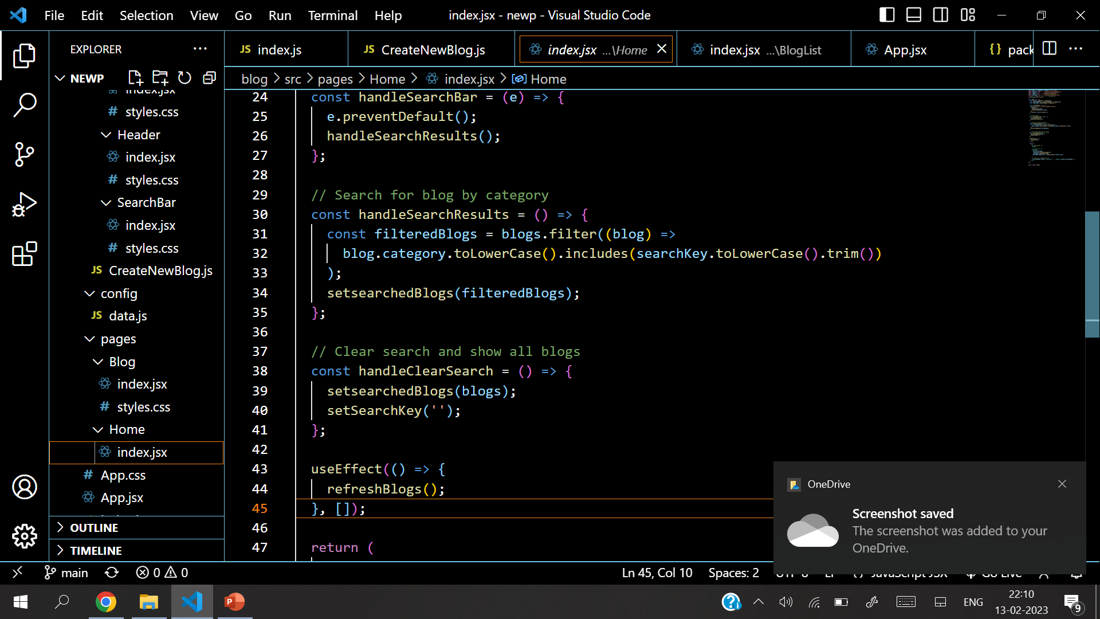
Source Code

Slide 16
Source Code

Slide 17
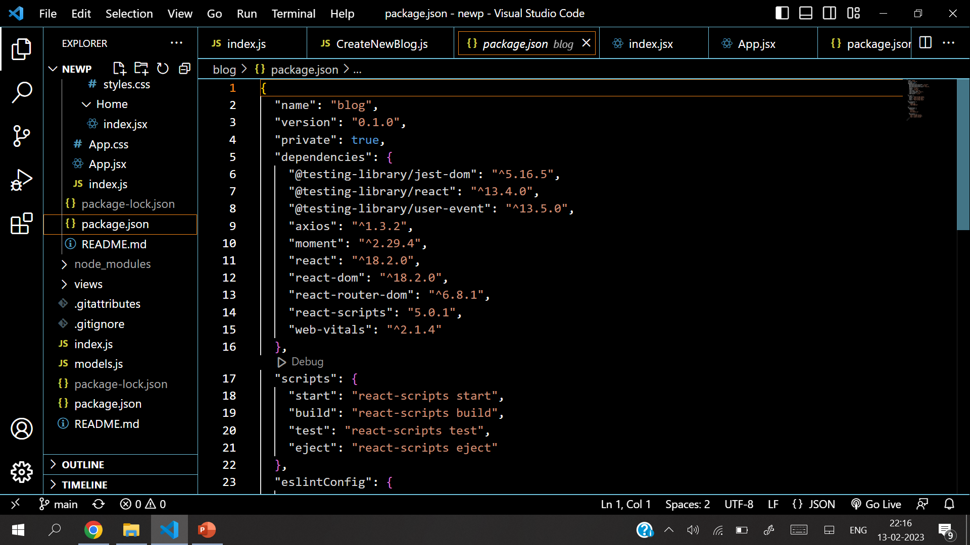
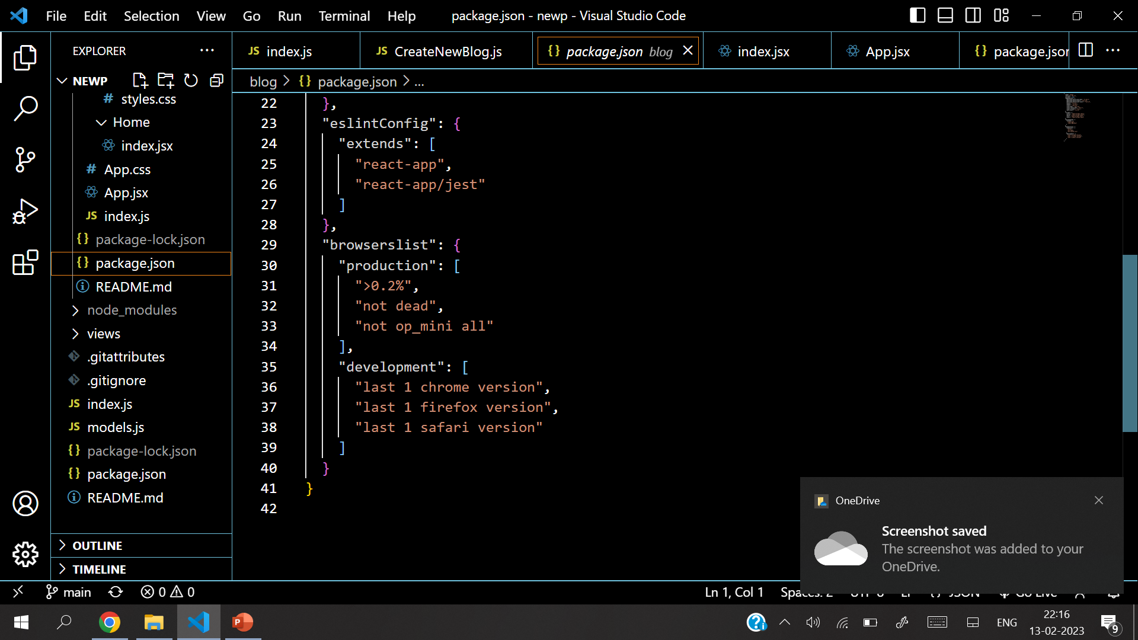
Source Code

Slide 18
Source Code

Slide 19
Bibliography
https://www.w3schools.com
https://www.github.com
https://www.youtube.com
https://www.javascripttutorial.net
https://www.mongodb.com
https://www.reactjs.com

Slide 20
Thank You

